Slide 1

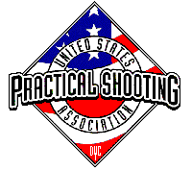
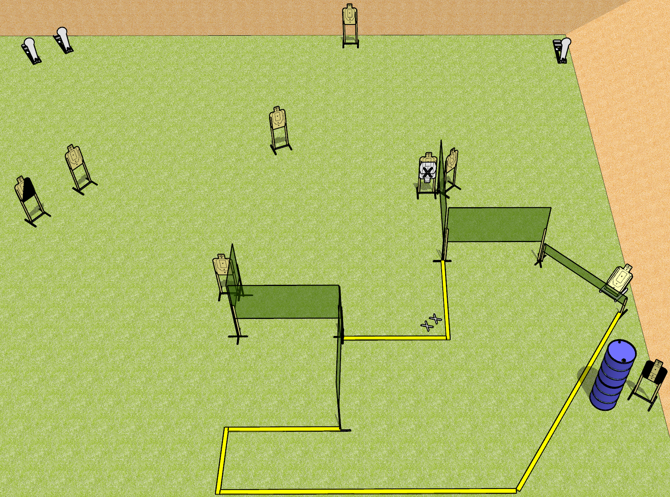
 | Dothan Gun Club – USPSA Match Empty Tank Course Designer : Drew Coleman
Round Count 21 rounds 9 USPSA 3 colt poppers
Equipment List 9 wall feet 1 left dia, 1 tux 8 targets (7 + 1 NS)

Slide 2
Empty Tank
Written Stage Briefing
Empty Tank is a 21 round, 110 point, Comstock course of fire. There are 9 USPSA targets and 3 steel. The best 2 hits on cardboard will score, and steel must fall to score.
Handgun start position is feet on X’s, wrists above respective shoulders. Handgun is UNLOADED and holstered.
PCC start position is feet on X’s, stock on belt. UNLOADED carbine is held with both hands.
On the audible start signal, engage targets as they become available from within the shooting area.

